Slide 1
DSO510 Project 2
Cheng CHEN, Cheng ZHANG, Jie CHEN,
Mi ZHONG, Xinyu LIANG, Yang LU, Yinghan LIU

Slide 2
Goal Definition
Analyze the relationship between gross box office of a movie and other independent variables including genre, budget, popularity of director and cast, etc., in order to:
guide film producers/investors on how to make high-quality movies, and
help movie theaters predict which movies will generate higher box office

Slide 3
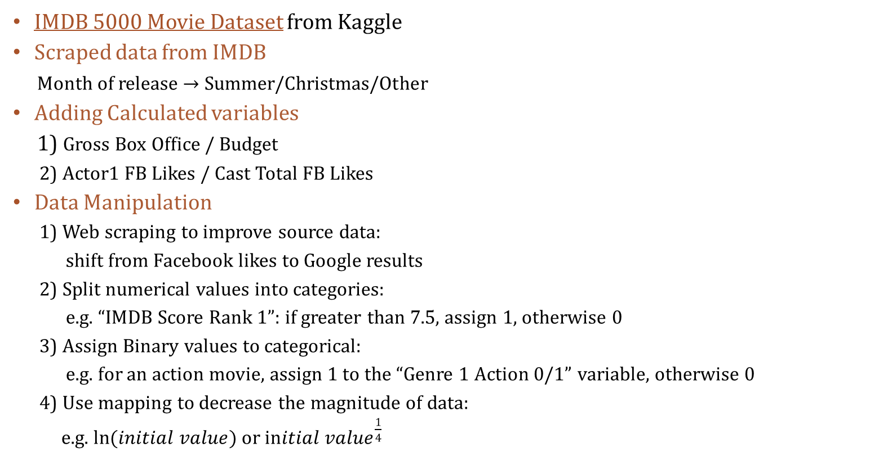
Data Collection & MANIPULATION
IMDB 5000 Movie Dataset from Kaggle
Scraped data from IMDB
Month of release → Summer/Christmas/Other
Adding Calculated variables
1) Gross Box Office / Budget
2) Actor1 FB Likes / Cast Total FB Likes
Data Manipulation
1) Web scraping to improve source data:
shift from Facebook likes to Google results
2) Split numerical values into categories:
e.g. “IMDB Score Rank 1”: if greater than 7.5, assign 1, otherwise 0
3) Assign Binary values to categorical:
e.g. for an action movie, assign 1 to the “Genre 1 Action 0/1” variable, otherwise 0
4) Use mapping to decrease the magnitude of data:
e.g. $\ln{(initial value)}$ or ${initial value}^{\frac{1}{4}}$

Slide 4
Variables
Gross Box Office | Duration Country MPAA Rating Director FB Likes Cast Total Facebook Likes Genre | Budget Num critics for reviews IMDB Score Summer/Christmas Release (Day, Month, Year) Gross/Budget Actor1/Cast Total FB Likes | Gross Rank 1 (>70,000) Gross Rank 2 (<1,000) Gross Rank 3 (70,000~1,000) Genre 1 Action 0/1 Genre 1 Fantasy 0/1 Genre 1 Happy 0/1 Genre 1 Tension 0/1 Genre 1 Documentary 0/1
IMDB | Duration Country MPAA Rating Director FB Likes Cast Total Facebook Likes Genre | Budget Number of critics for reviews Total FB Likes of Actor 1, 2, 3 Gross/Budget | IMDB RANK 1 (if great, 7.5) IMDB RANK 2 (if great, 5.5) IMDB RANK 3 (3 levels, 7.5, 5.5) Genre 1 Action 0/1 Genre 1 Fantasy 0/1 Genre 1 Happy 0/1 Genre 1 Tension 0/1 Genre 1 Documentary 0/1

Slide 5
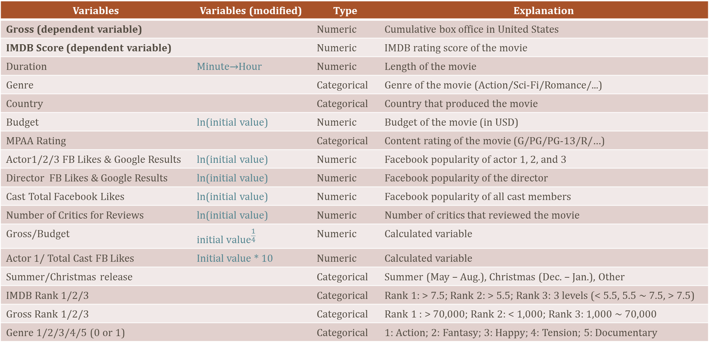
Variables
Variables | Variables (modified) | Type | Explanation
Gross (dependent variable) |  | Numeric | Cumulative box office in United States
IMDB Score (dependent variable) |  | Numeric | IMDB rating score of the movie
Duration | Minute→Hour | Numeric | Length of the movie
Genre |  | Categorical | Genre of the movie (Action/Sci-Fi/Romance/...)
Country |  | Categorical | Country that produced the movie
Budget | ln(initial value) | Numeric | Budget of the movie (in USD)
MPAA Rating |  | Categorical | Content rating of the movie (G/PG/PG-13/R/…)
Actor1/2/3 FB Likes & Google Results | ln(initial value) | Numeric | Facebook popularity of actor 1, 2, and 3
Director FB Likes & Google Results | ln(initial value) | Numeric | Facebook popularity of the director
Cast Total Facebook Likes | ln(initial value) | Numeric | Facebook popularity of all cast members
Number of Critics for Reviews | ln(initial value) | Numeric | Number of critics that reviewed the movie
Gross/Budget | $${initial value}^{\frac{1}{4}}$$ | Numeric | Calculated variable
Actor 1/ Total Cast FB Likes | Initial value * 10 | Numeric | Calculated variable
Summer/Christmas release |  | Categorical | Summer (May – Aug.), Christmas (Dec. – Jan.), Other
IMDB Rank 1/2/3 |  | Categorical | Rank 1: > 7.5; Rank 2: > 5.5; Rank 3: 3 levels (< 5.5, 5.5 ~ 7.5, > 7.5)
Gross Rank 1/2/3 |  | Categorical | Rank 1 : > 70,000; Rank 2: < 1,000; Rank 3: 1,000 ~ 70,000
Genre 1/2/3/4/5 (0 or 1) |  | Categorical | 1: Action; 2: Fantasy; 3: Happy; 4: Tension; 5: Documentary

Slide 6
Categorical Variables & Levels
Class | Levels | Values
MPAA Rating | 6 | G, PG, PG-13, R, NC-17, NA
Continent | 6 | Africa, Asia, Europe, North America, Oceania, South America
Release Time | 3 | Summer (May – Aug.), Christmas (Dec. – Jan.), Other
Genre Category | 5 | Action, Documentary, Fantasy, Happy Hour, Tension
Action | Documentary | Fantasy | Happy Hour | Tension
Adventure Action | News Documentary History War Biography | Sci-Fi Fantasy | Family Comedy Sport Romance Music/Musical Animation | Thriller Horror Crime Mystery

Slide 7
Gross box office and recommendation

Slide 8

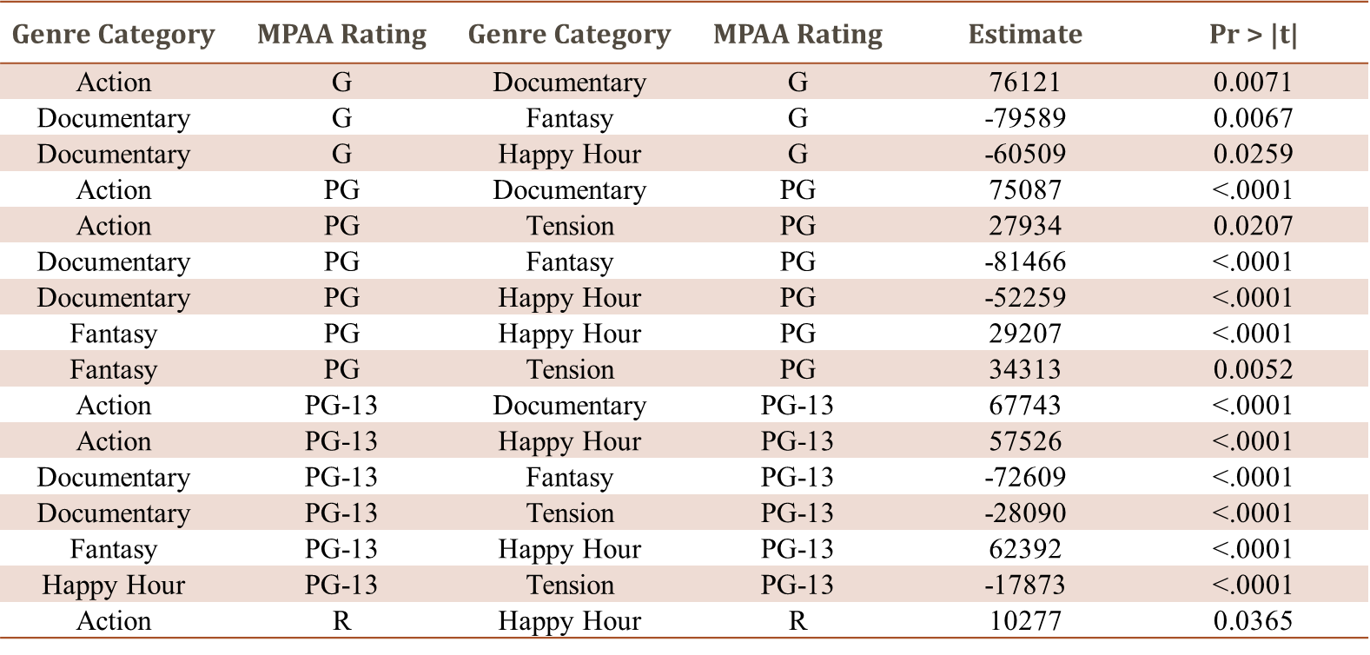
Movies with fascinating visual effects tend to have higher gross box office.
A fantasy/sci-fi/action movie always generates the highest gross box office, regardless of its MPAA rating.

Slide 9

Releasing movies during holidays contributes to higher gross box office.
Gross box office of summer vacation are usually better than that of Christmas.
However, for biography/history/documentary movies, Christmas can be a good choice.
Christmas | Other | 9324.04
Christmas | Summer | -24992
Other | Summer | -34316
Documentary | Christmas | Documentary | Other | 21054
Documentary | Christmas | Documentary | Summer | 22344
Bibliography released during Christmas/New Year season,
GBO: $170.7 million (2001)

Slide 10

Recommendation for Movie Producers
Movie producers can add more exciting elements into the movie – science fiction themes, action scenes, etc.
Release movies during holiday seasons.

Slide 11

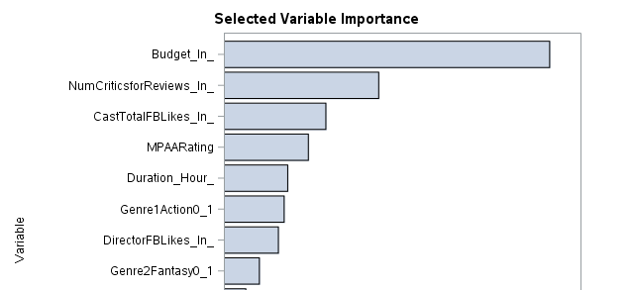
Investment in movie production, reputation and actor popularity are the most important factors.
Budget: $300 million
GBO: $309 million (2007)

Slide 12

Recommendation to Movie Theaters
Playing high-investment movies more frequently may bring a theater higher revenue.
Select the movies whose casts enjoy high reputation and popularity.

Slide 13

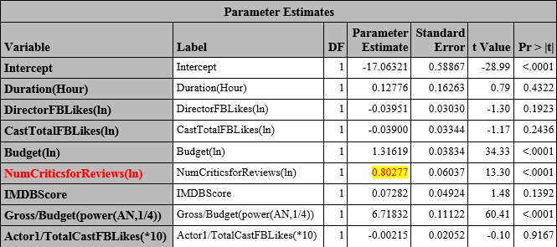
Cooperation between theaters and directors – prescreen movies and invite critics to write more reviews before or during the releasing period.
Number of Critics: 813 (avg. 175)
GBO: $448 million (2012)

Slide 14
IMDB SCORE and recommendation

Slide 15

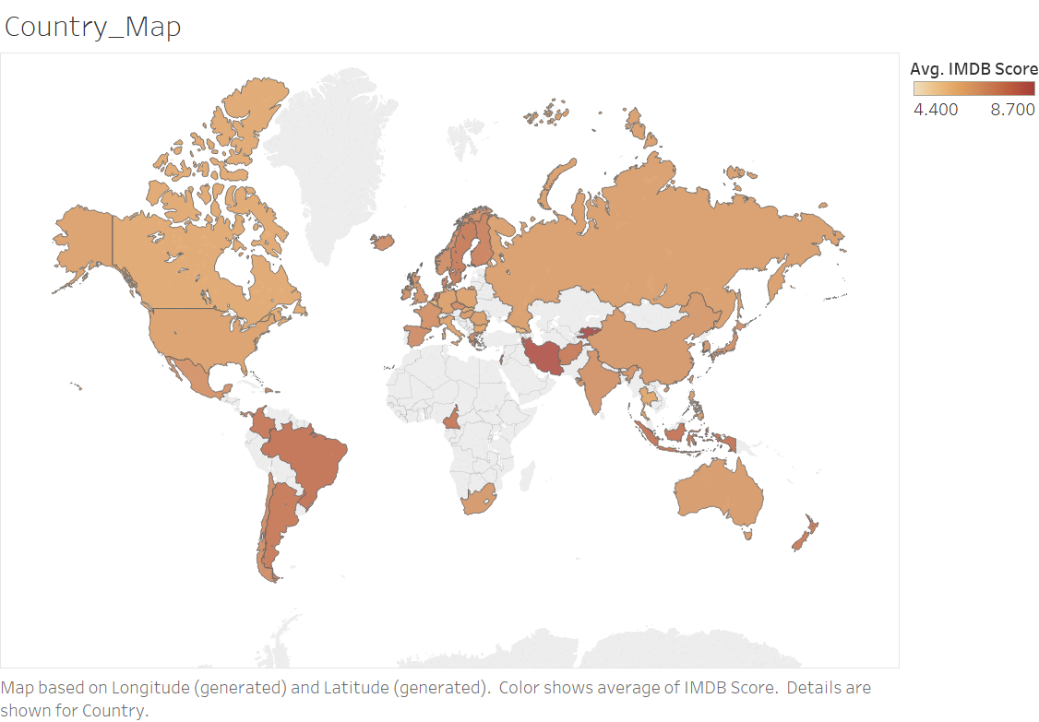
Identify the best combination between certain topic and country; invite famous director and his producing team to film their specialized movie in certain theme of that area. e.g. Crime movie & Brazil, Documentary & Israel.
Genre: Crime
Country: Brazil
IMDB Score: 8.7
North European, Middle East, Southeast Asia and South America have revealed great potential, especially countries like Iran, Brazil, Israel and Indonesia

Slide 16

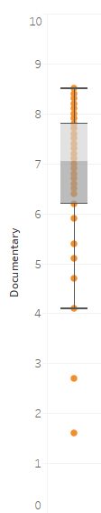
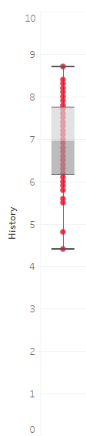
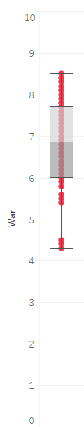
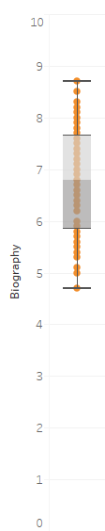
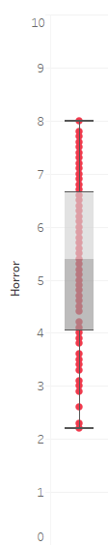
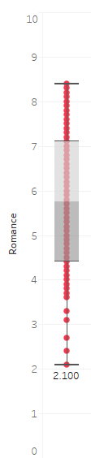
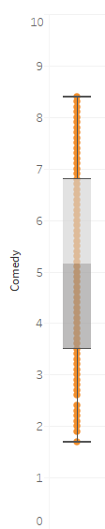
Avoid blind investment; in terms of reputation, the producer might want to try movies with serious theme; if a cliché genre is a must, better find novel topics and the best scripts.
Documentary History War Biography Horror Comedy Romance
Genre: Comedy
IMDB Score: 7.8
Genres like biography, documentary, history and war have higher average IMDB Score and tight score distribution, while comedy, horror and romance have lower average IMDB score and longer score distribution.

Slide 17

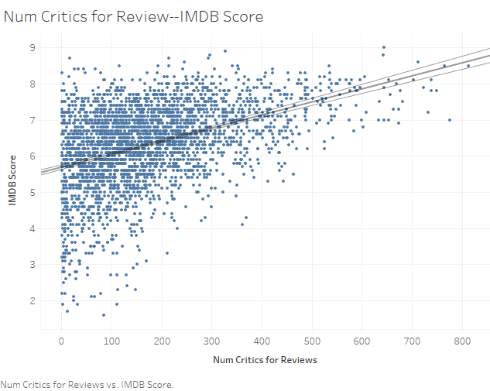
Invite multiple levels of audience (fans of cast, loyal reader of the writer, movie critics, etc.) to expand the movie’s influence; Initiate topics on social media to attract attention and increase pages of views; have peer actors on social media to forward the movie information to their fans.
High positive correlation between IMDB Score and
Number of Critics for Reviews.
Number of critics: 552
IMDB Score: 8

Slide 18

When filming a Crime/Horror/Thriller/Mystery movie, show the ULTIMITE BEAUTY of this topic (make it R-rated!)
Genre Category | MPAA Rating | Genre Category | MPAA Rating | Estimate | Pr > |t|
Tension | PG-13 | Tension | R | -0.2362 | 0.0003
Tension | PG | Tension | R | -0.3556 | 0.0376
Fixed Genre
Fixed Genre:
Tension: R > PG-13 > PG
MPAA Rating: R
Genre: Thriller
Key word: Violence aesthetics
IMDB Score: 8.1

Slide 19

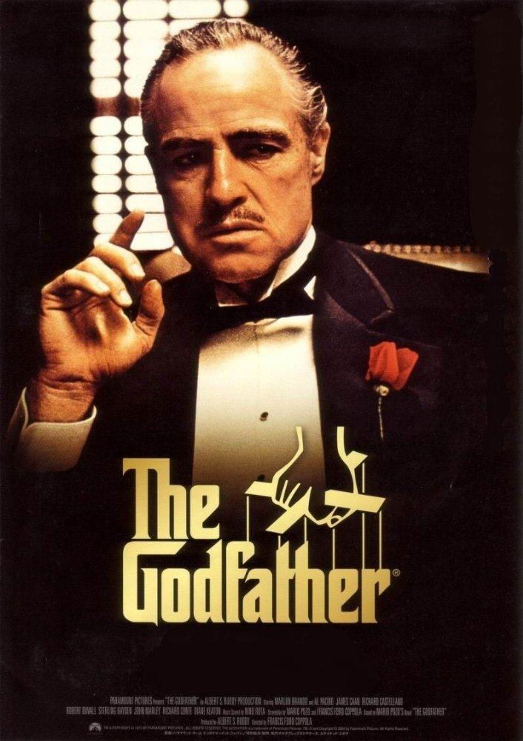
To film a century-classic movie, don’t get trapped in the limited duration, leave certain space for the story to develop and stretch.
Duration: 154min
IMDB Score: 8.9
Duration: 175min
IMDB Score: 9.2
Duration is another important variable for IMDB Score

Slide 20
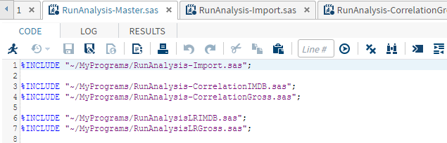
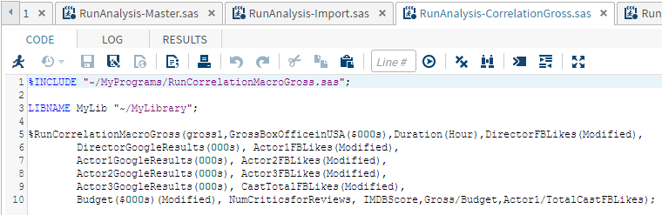
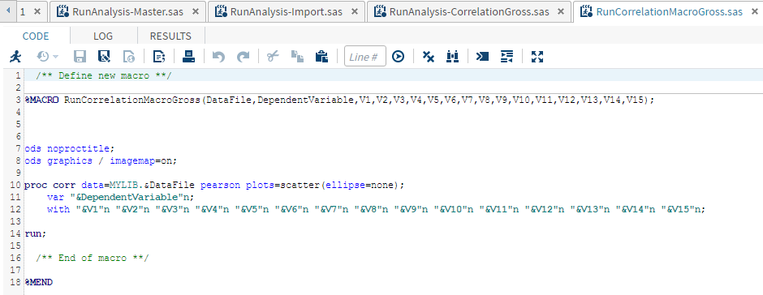
Sas macro
Master Program
Secondary Program
Macro Program

Slide 21
Dashboard of Project Results
Complementary Website

Slide 22
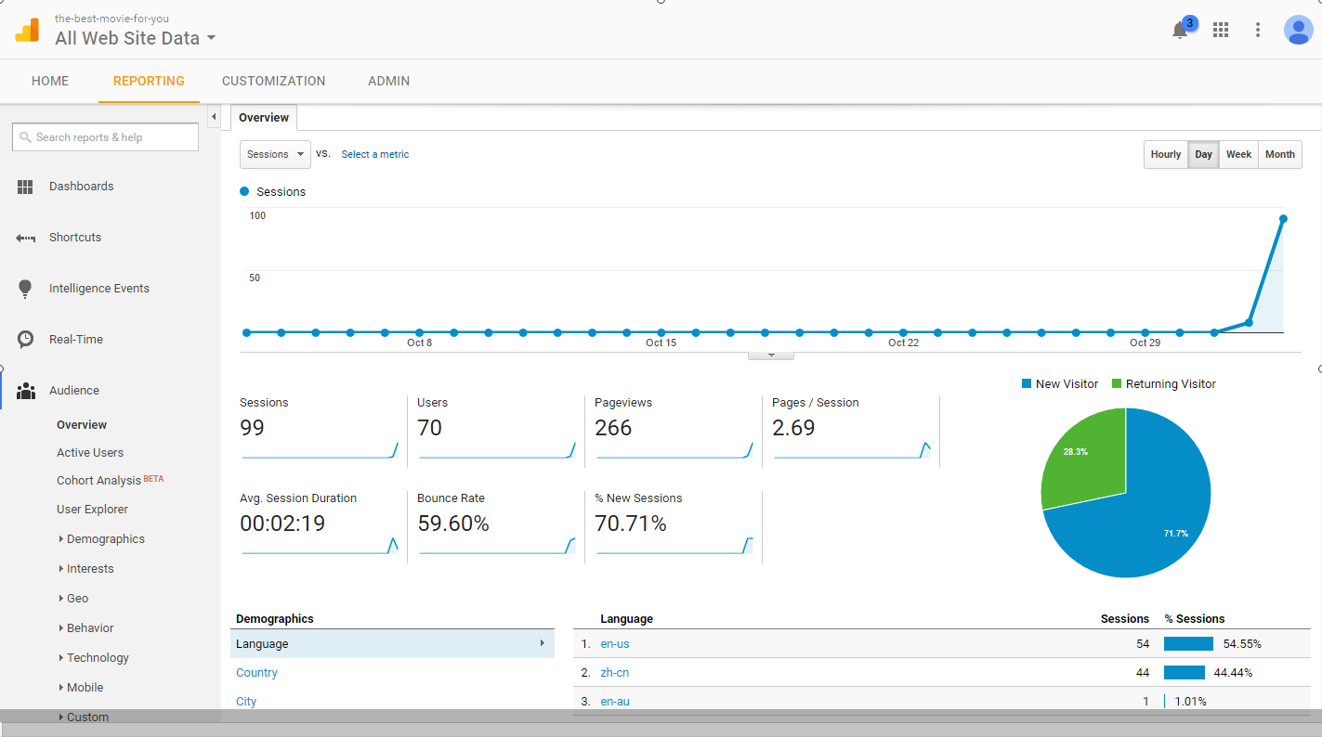
Google ANALYTICS

Slide 23
Thank you!

